Slide 1
Strengthening Zonta District 25 Recruiting and Retaining Members Advocacy Initiatives to Build a Better World for Women and Girls
Asian Inter District Meeting – Fukuoka, Japan
Presented by Lt Governor D25 Ratten Abdulhussein

Slide 2
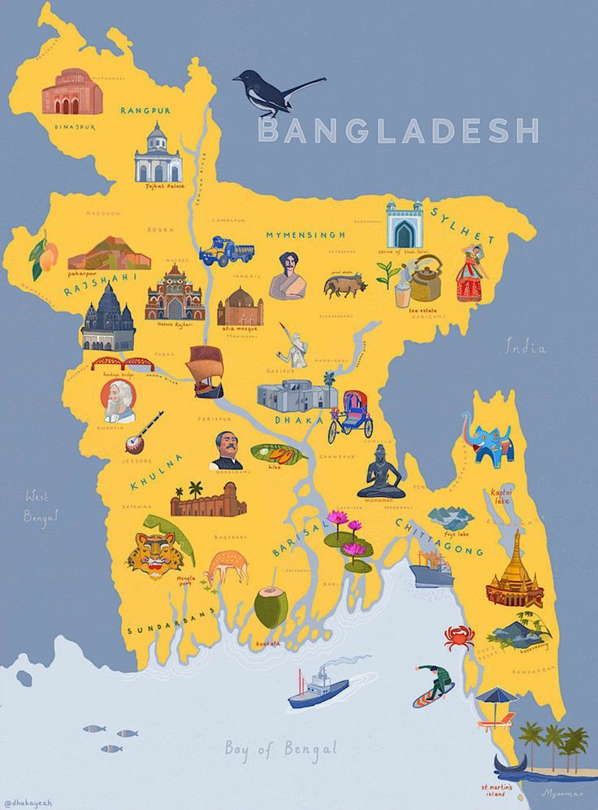
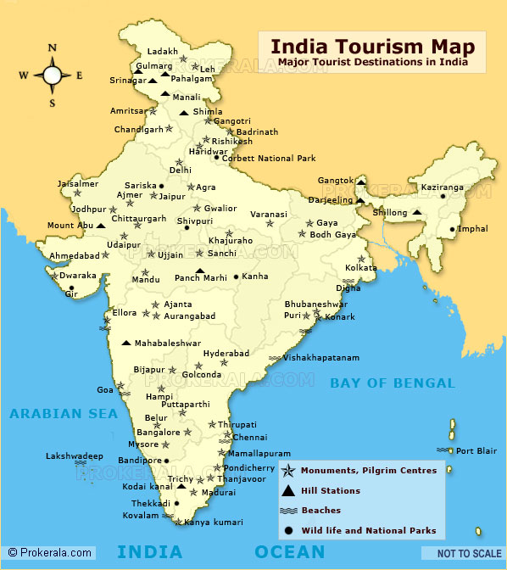
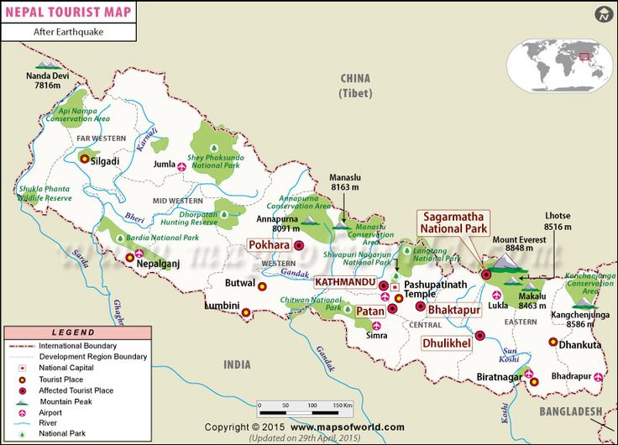
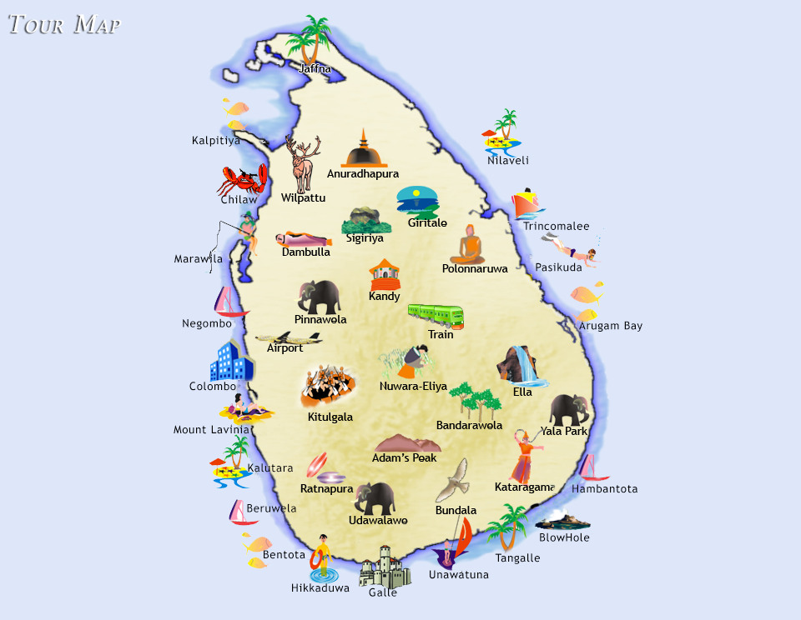
Recruiting and Retaining Members
Current Membership Landscape in District 25
Bangladesh 6 Clubs 5 Z and Golden Z | India 2 Clubs 2 Z and Golden Z | Nepal 3 Clubs 5 Z and Golden Z | Sri Lanka 4 Clubs 3 Z and Golden Z

Slide 3
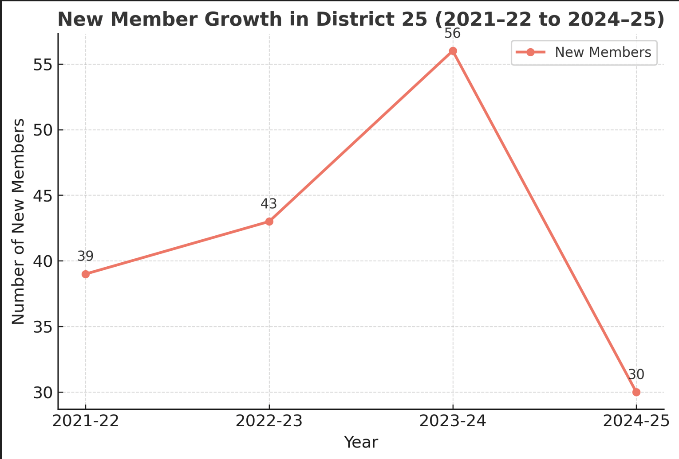
Recruiting and Retaining Members
Key Statistics
Total Number of Clubs: 15 Z and Golden Z Clubs : 15
Active Members: 435 members across all four countries 20 Young Professional members
2024-25 statistics upto January 2025

Slide 4
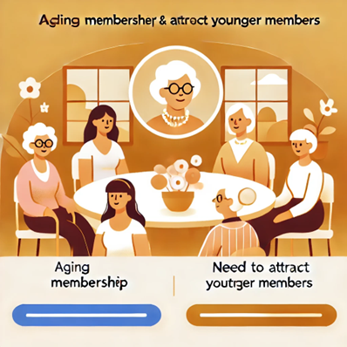
Recruiting and Retaining Members
Challenges Faced
Aging Membership: A significant portion of our members are senior, requiring targeted efforts to attract younger members.
Member Engagement: Declining participation in club activities due to professional and personal commitments.
Visibility and Awareness: Zonta’s mission and impact are not widely known among younger generations.
Competition: Growing number of NGOs and professional networks competing for members' time and commitment.
Opportunities
Strong foundation of experienced and committed members.
Expanding interest in gender equality and women's empowerment globally.
Leverage social media and digital platforms to reach a younger demographic.

Slide 5
Recruiting and Retaining Members
Retention Strategies
Engagement and Value:
Create meaningful projects aligned with Zonta’s mission
Leadership and personal development opportunities
Regular communication and feedback channels
Recognition and Appreciation:
Celebrate member milestones and contributions
Member awards and public recognition
Inclusive Environment:
Encourage diverse perspectives and ideas
Provide mentorship opportunities

Slide 6
Recruiting and Retaining Members
Recruitment Strategies
Women Professionals
Networking Opportunities
Professional Development
Visibility and Recognition
Young Leaders
Social Media Engagement
Empowerment Programs
Incentivize Membership
Advocates for Equality
Advocacy Campaigns
Partnerships
Share Stories to inspire

Slide 7
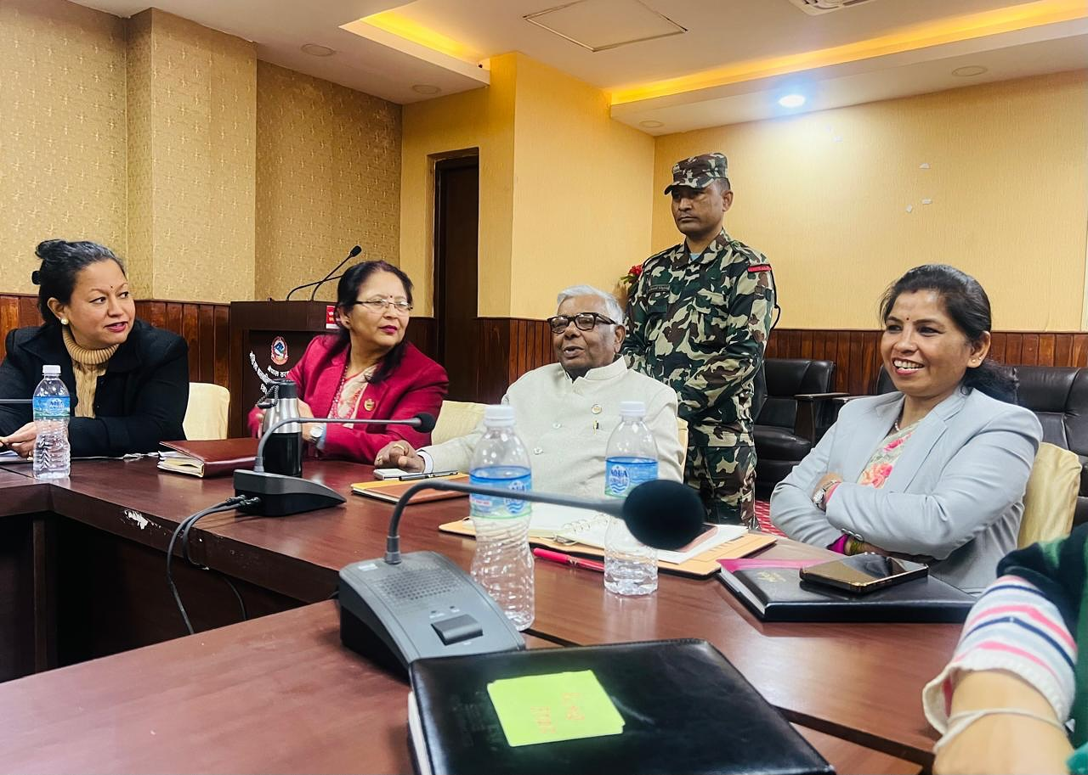
Advocacy Initiatives to Build a Better World for Women and Girls
Zonta Club of Kathmandu
Participated and shared the recommendations on Ending Child Marriage to be discussed during the 90th session on CEDAW.
The meeting was led by Honorable Minister, Ministry of Women, Children and Senior Citizens of Nepal,.

Slide 8
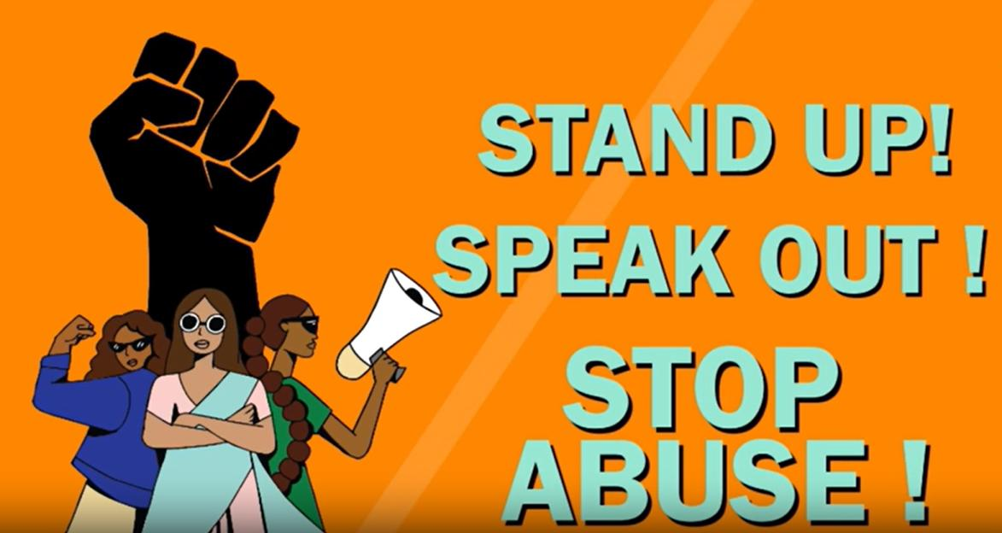
Advocacy Initiatives to Build a Better World for Women and Girls
Gender based violence advocacy programmes
By Zonta Club of Dhaka II
Billboard campaigns by Zonta Clubs of Colombo

Slide 9
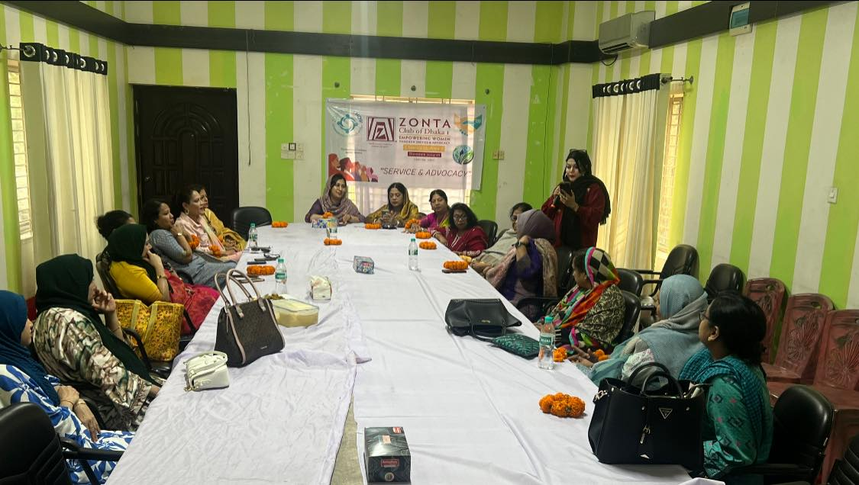
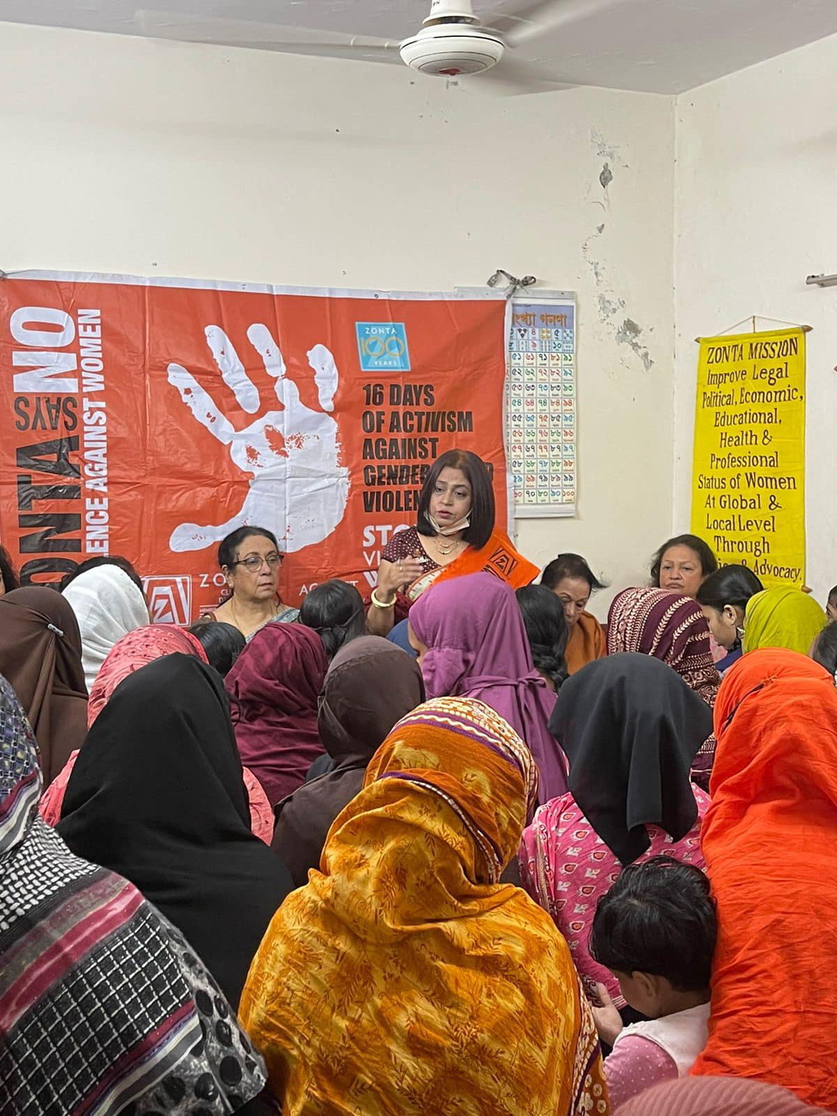
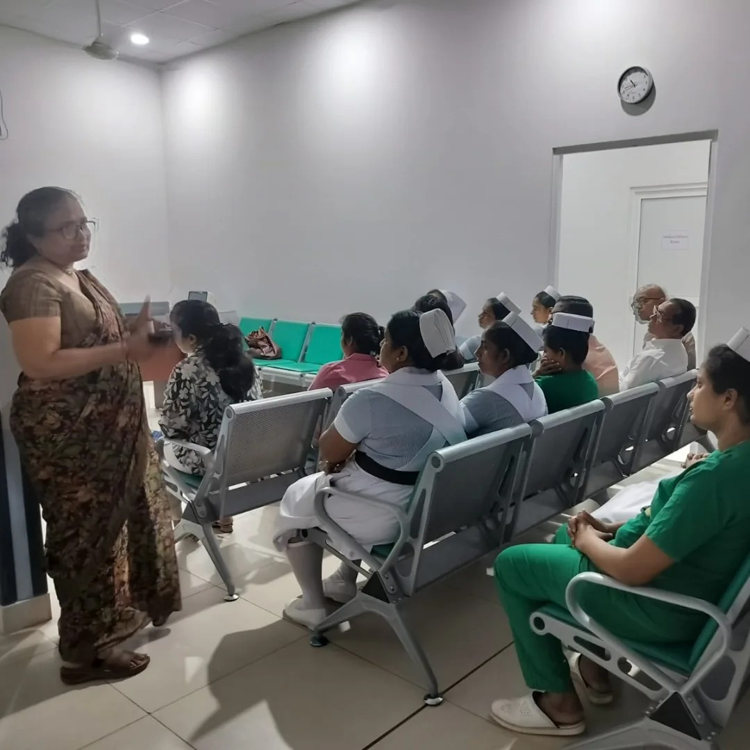
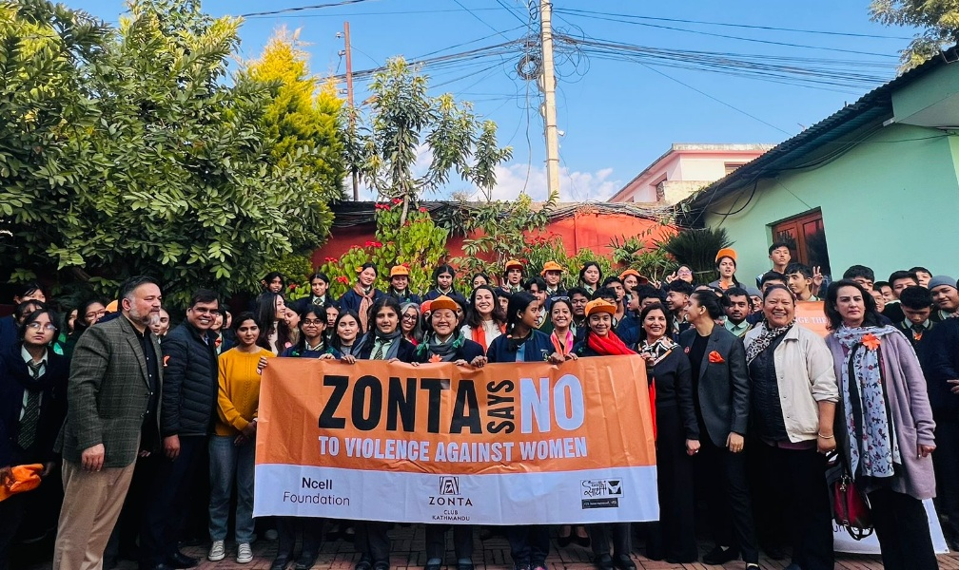
Advocacy Initiatives to Build a Better World for Women and Girls
..Advocacy programs/sessions

Slide 10
Advocacy Initiatives to Build a Better World for Women and Girls

Slide 11
Advocacy Initiatives to Build a Better World for Women and Girls

